Slide 1
D&C and Dynamic Programming
Hyerim Bae
Department of Industrial Engineering, Pusan National University
hrbae@pusan.ac.kr

Slide 2
Sorting
A[ ] = {21, 45, 31, 50, 3, 97, 1, 5, 40, 81}
A 안에 있는 원소들을 크기 순으로 나열하도록 A를 update하면?

Slide 3
Priority Queue ADT
A priority queue stores a collection of entries
Each entry is a pair (key, value)
Main methods of the Priority Queue ADT
insert(k, x) inserts an entry with key k and value x
removeMin() removes and returns the entry with smallest key
Additional methods
min() returns, but does not remove, an entry with smallest key
size(), isEmpty()
Applications:
Standby flyers
Auctions
Stock market

Slide 4
Priority Queue Sorting (§ 7.1.4)
We can use a priority queue to sort a set of comparable elements
Insert the elements one by one with a series of insert operations
Remove the elements in sorted order with a series of removeMin operations
The running time of this sorting method depends on the priority queue implementation
Algorithm PQ-Sort(S, C)
Input sequence S, comparator C for the elements of S
Output sequence S sorted in increasing order according to C
P ← priority queue with comparator C
while ¬S.isEmpty ()
e ← S.removeFirst ()
P.insert (e.key(), e.value())
while ¬P.isEmpty()
e ← P.removeMin()
S.insertLast(e)

Slide 5
Sequence-based Priority Queue
Implementation with an unsorted list
Performance:
insert takes O(1) time since we can insert the item at the beginning or end of the sequence
removeMin and min take O(n) time since we have to traverse the entire sequence to find the smallest key
Implementation with a sorted list
Performance:
insert takes O(n) time since we have to find the place where to insert the item
removeMin and min take O(1) time, since the smallest key is at the beginning
4
5
2
3
1
1
2
3
4
5

Slide 6
In-place Insertion-sort
Instead of using an external data structure, we can implement selection-sort and insertion-sort in-place
A portion of the input sequence itself serves as the priority queue
For in-place insertion-sort
We keep sorted the initial portion of the sequence
We can use swaps instead of modifying the sequence
5
4
2
3
1
5
4
2
3
1
4
5
2
3
1
2
4
5
3
1
2
3
4
5
1
1
2
3
4
5
1
2
3
4
5

Slide 7
Heaps
2
5
6
9
7

Slide 8

Recall Priority Queue Sorting (§ 7.1.4)
We can use a priority queue to sort a set of comparable elements
Insert the elements with a series of insert operations
Remove the elements in sorted order with a series of removeMin operations
The running time depends on the priority queue implementation:
Unsorted sequence gives selection-sort: O(n²) time
Sorted sequence gives insertion-sort: O(n²) time
Can we do better?
Algorithm PQ-Sort(S, C)
Input sequence S, comparator C for the elements of S
Output sequence S sorted in increasing order according to C
P ← priority queue with comparator C
while ¬S.isEmpty ()
e ← S.remove (S. first ())
P.insertItem(e, e)
while ¬P.isEmpty()
e ← P.removeMin()
S.insertLast(e)

Slide 9
Heaps (§7.3)
A heap is a binary tree storing keys at its nodes and satisfying the following properties:
Heap-Order: for every internal node v other than the root, key(v) ≥ key(parent(v))
Complete Binary Tree: let h be the height of the heap
for i = 0, … , h − 1, there are 2^{i} nodes of depth i
at depth h − 1, the internal nodes are to the left of the external nodes
The last node of a heap is the rightmost node of depth h
2
5
6
9
7
last node

Slide 10
Height of a Heap (§ 7.3.1)
Theorem: A heap storing n keys has height O(log n)
Proof: (we apply the complete binary tree property)
Let h be the height of a heap storing n keys
Since there are 2^{i} keys at depth i = 0, … , h − 1 and at least one key at depth h, we have n ≥ 1 + 2 + 4 + … + 2^{h−1} + 1
Thus, n ≥ 2^{h} , i.e., h ≤ log n
depth
keys
0
1
1
2
h−1
2^{h−1}
h
1

Slide 11
Heaps and Priority Queues
We can use a heap to implement a priority queue
We store a (key, element) item at each internal node
We keep track of the position of the last node
For simplicity, we show only the keys in the pictures
(2, Sue)
(5, Pat)
(6, Mark)
(9, Jeff)
(7, Anna)

Slide 12
Insertion into a Heap (§ 7.3.3)
Method insertItem of the priority queue ADT corresponds to the insertion of a key k to the heap
The insertion algorithm consists of three steps
Find the insertion node z (the new last node)
Store k at z
Restore the heap-order property (discussed next)
2
5
z
6
9
7
insertion node
2
5
6
z
9
7
1

Slide 13
Upheap
After the insertion of a new key k, the heap-order property may be violated
Algorithm upheap restores the heap-order property by swapping k along an upward path from the insertion node
Upheap terminates when the key k reaches the root or a node whose parent has a key smaller than or equal to k
Since a heap has height O(log n), upheap runs in O(log n) time
2
1
5
1
5
2
z
z
9
7
6
9
7
6

Slide 14
Removal from a Heap (§ 7.3.3)
Method removeMin of the priority queue ADT corresponds to the removal of the root key from the heap
The removal algorithm consists of three steps
Replace the root key with the key of the last node w
Remove w
Restore the heap-order property (discussed next)
2
5
6
w
9
7
last node
7
5
w
6
9
new last node

Slide 15
Downheap
After replacing the root key with the key k of the last node, the heap-order property may be violated
Algorithm downheap restores the heap-order property by swapping key k along a downward path from the root
Downheap terminates when key k reaches a leaf or a node whose children have keys greater than or equal to k
Since a heap has height O(log n), downheap runs in O(log n) time
7
5
5
w
6
7
w
6
9
9

Slide 16
Updating the Last Node
The insertion node can be found by traversing a path of O(log n) nodes
Go up until a left child or the root is reached
If a left child is reached, go to the right child
Go down left until a leaf is reached
Similar algorithm for updating the last node after a removal
How to find next insertion node?

Slide 17
Heap-Sort (§2.4.4)
Consider a priority queue with n items implemented by means of a heap
the space used is O(n)
methods insert and removeMin take O(log n) time
methods size, isEmpty, and min take time O(1) time
Using a heap-based priority queue, we can sort a sequence of n elements in O(n log n) time
The resulting algorithm is called heap-sort
Heap-sort is much faster than quadratic sorting algorithms, such as insertion-sort and selection-sort

Slide 18
Vector-based Heap Implementation (§2.4.3)
We can represent a heap with n keys by means of a vector of length n + 1
For the node at rank i
the left child is at rank 2i
the right child is at rank 2i + 1
Links between nodes are not explicitly stored
The cell of at rank 0 is not used
Operation insert corresponds to inserting at rank n + 1
Operation removeMin corresponds to removing at rank n
Yields in-place heap-sort
2
5
6
9
7
2
5
6
9
7
0
1
2
3
4
5

Slide 19
Merging Two Heaps
We are given two heaps and a key k
We create a new heap with the root node storing k and with the two heaps as subtrees
We perform downheap to restore the heap-order property
3
2
8
5
4
6
7
3
2
8
5
4
6
2
3
4
8
5
7
6

Slide 20
Bottom-up Heap Construction (§2.4.3)
We can construct a heap storing n given keys in using a bottom-up construction with log n phases
In phase i, pairs of heaps with 2^{i} −1 keys are merged into heaps with 2^{i+1}−1 keys
2^{i} −1
2^{i} −1
2^{i+1}−1

Slide 21
Example
16
15
4
12
6
7
23
20
25
5
11
27
16
15
4
12
6
7
23
20

Slide 22
Example (contd.)
25
5
11
27
16
15
4
12
6
9
23
20
15
4
6
23
16
25
5
12
11
9
27
20

Slide 23
Example (contd.)
7
8
15
4
6
23
16
25
5
12
11
9
27
20
4
6
15
5
8
23
16
25
7
12
11
9
27
20

Slide 24
Example (end)
10
4
6
15
5
8
23
16
25
7
12
11
9
27
20
4
5
6
15
7
8
23
16
25
10
12
11
9
27
20

Slide 25
Analysis
We visualize the worst-case time of a downheap with a proxy path that goes first right and then repeatedly goes left until the bottom of the heap (this path may differ from the actual downheap path)
Since each node is traversed by at most two proxy paths, the total number of nodes of the proxy paths is O(n)
Thus, bottom-up heap construction runs in O(n) time
Bottom-up heap construction is faster than n successive insertions and speeds up the first phase of heap-sort

Slide 26
Merge Sort
7 2 ⏐ 9 4 → 2 4 7 9
7 ⏐ 2 → 2 7
9 ⏐ 4 → 4 9
7 → 7
2 → 2
9 → 9
4 → 4

Slide 27
Divide-and-Conquer (§ 10.1.1)
Divide-and conquer is a general algorithm design paradigm:
Divide: divide the input data S in two disjoint subsets S₁ and S₂
Recur: solve the subproblems associated with S₁ and S₂
Conquer: combine the solutions for S₁ and S₂ into a solution for S
The base case for the recursion are subproblems of size 0 or 1
Merge-sort is a sorting algorithm based on the divide-and-conquer paradigm
Like heap-sort
It uses a comparator
It has O(n log n) running time
Unlike heap-sort
It does not use an auxiliary priority queue
It accesses data in a sequential manner (suitable to sort data on a disk)

Slide 28
Merge-Sort (§ 10.1)
Merge-sort on an input sequence S with n elements consists of three steps:
Divide: partition S into two sequences S₁ and S₂ of about n/2 elements each
Recur: recursively sort S₁ and S₂
Conquer: merge S₁ and S₂ into a unique sorted sequence
Algorithm mergeSort(S, C)
Input sequence S with n elements, comparator C
Output sequence S sorted
according to C
if S.size() > 1
(S₁, S₂) ← partition(S, n/2)
mergeSort(S₁, C)
mergeSort(S₂, C)
S ← merge(S₁, S₂)

Slide 29
Merging Two Sorted Sequences
The conquer step of merge-sort consists of merging two sorted sequences A and B into a sorted sequence S containing the union of the elements of A and B
Merging two sorted sequences, each with n/2 elements and implemented by means of a doubly linked list, takes O(n) time
Algorithm merge(A, B)
Input sequences A and B with n/2 elements each
Output sorted sequence of A ∪ B
S ← empty sequence
while ¬A.isEmpty() ∧ ¬B.isEmpty()
if A.first().element() < B.first().element()
S.insertLast(A.remove(A.first()))
else
S.insertLast(B.remove(B.first()))
while ¬A.isEmpty() S.insertLast(A.remove(A.first()))
while ¬B.isEmpty() S.insertLast(B.remove(B.first()))
return S

Slide 30
Merge-Sort Tree
An execution of merge-sort is depicted by a binary tree
each node represents a recursive call of merge-sort and stores
unsorted sequence before the execution and its partition
sorted sequence at the end of the execution
the root is the initial call
the leaves are calls on subsequences of size 0 or 1
7 2 ⏐ 9 4 → 2 4 7 9
7 ⏐ 2 → 2 7
9 ⏐ 4 → 4 9
7 → 7
2 → 2
9 → 9
4 → 4

Slide 31
Execution Example
Partition
7 2 9 4 ⏐ 3 8 6 1 → 1 2 3 4 6 7 8 9
7 2 9 4 → 2 4 7 9
3 8 6 1 → 1 3 8 6
7 2 → 2 7
9 4 → 4 9
3 8 → 3 8
6 1 → 1 6
7 → 7
2 → 2
9 → 9
4 → 4
3 → 3
8 → 8
6 → 6
1 → 1

Slide 32
Execution Example (cont.)
Recursive call, partition
7 2 9 4 ⏐ 3 8 6 1 → 1 2 3 4 6 7 8 9
7 2 ⏐ 9 4 → 2 4 7 9
3 8 6 1 → 1 3 8 6
7 2 → 2 7
9 4 → 4 9
3 8 → 3 8
6 1 → 1 6
7 → 7
2 → 2
9 → 9
4 → 4
3 → 3
8 → 8
6 → 6
1 → 1

Slide 33
Execution Example (cont.)
Recursive call, partition
7 2 9 4 ⏐ 3 8 6 1 → 1 2 3 4 6 7 8 9
7 2 ⏐ 9 4 → 2 4 7 9
3 8 6 1 → 1 3 8 6
7 ⏐ 2 → 2 7
9 4 → 4 9
3 8 → 3 8
6 1 → 1 6
7 → 7
2 → 2
9 → 9
4 → 4
3 → 3
8 → 8
6 → 6
1 → 1

Slide 34
Execution Example (cont.)
Recursive call, base case
7 2 9 4 ⏐ 3 8 6 1 → 1 2 3 4 6 7 8 9
7 2 ⏐ 9 4 → 2 4 7 9
3 8 6 1 → 1 3 8 6
7 ⏐ 2 → 2 7
9 4 → 4 9
3 8 → 3 8
6 1 → 1 6
7 → 7
2 → 2
9 → 9
4 → 4
3 → 3
8 → 8
6 → 6
1 → 1

Slide 35
Execution Example (cont.)
Recursive call, base case
7 2 9 4 ⏐ 3 8 6 1 → 1 2 3 4 6 7 8 9
7 2 ⏐ 9 4 → 2 4 7 9
3 8 6 1 → 1 3 8 6
7 ⏐ 2 → 2 7
9 4 → 4 9
3 8 → 3 8
6 1 → 1 6
7 → 7
2 → 2
9 → 9
4 → 4
3 → 3
8 → 8
6 → 6
1 → 1

Slide 36
Execution Example (cont.)
Merge
7 2 9 4 ⏐ 3 8 6 1 → 1 2 3 4 6 7 8 9
7 2 ⏐ 9 4 → 2 4 7 9
3 8 6 1 → 1 3 8 6
7 ⏐ 2 → 2 7
9 4 → 4 9
3 8 → 3 8
6 1 → 1 6
7 → 7
2 → 2
9 → 9
4 → 4
3 → 3
8 → 8
6 → 6
1 → 1

Slide 37
Execution Example (cont.)
Recursive call, …, base case, merge
7 2 9 4 ⏐ 3 8 6 1 → 1 2 3 4 6 7 8 9
7 2 ⏐ 9 4 → 2 4 7 9
3 8 6 1 → 1 3 8 6
7 ⏐ 2 → 2 7
9 4 → 4 9
3 8 → 3 8
6 1 → 1 6
7 → 7
2 → 2
9 → 9
4 → 4
3 → 3
8 → 8
6 → 6
1 → 1

Slide 38
Execution Example (cont.)
Merge
7 2 9 4 ⏐ 3 8 6 1 → 1 2 3 4 6 7 8 9
7 2 ⏐ 9 4 → 2 4 7 9
3 8 6 1 → 1 3 8 6
7 ⏐ 2 → 2 7
9 4 → 4 9
3 8 → 3 8
6 1 → 1 6
7 → 7
2 → 2
9 → 9
4 → 4
3 → 3
8 → 8
6 → 6
1 → 1

Slide 39
Execution Example (cont.)
Recursive call, …, merge, merge
7 2 9 4 ⏐ 3 8 6 1 → 1 2 3 4 6 7 8 9
7 2 ⏐ 9 4 → 2 4 7 9
3 8 6 1 → 1 3 6 8
7 ⏐ 2 → 2 7
9 4 → 4 9
3 8 → 3 8
6 1 → 1 6
7 → 7
2 → 2
9 → 9
4 → 4
3 → 3
8 → 8
6 → 6
1 → 1

Slide 40
Execution Example (cont.)
Merge
7 2 9 4 ⏐ 3 8 6 1 → 1 2 3 4 6 7 8 9
7 2 ⏐ 9 4 → 2 4 7 9
3 8 6 1 → 1 3 6 8
7 ⏐ 2 → 2 7
9 4 → 4 9
3 8 → 3 8
6 1 → 1 6
7 → 7
2 → 2
9 → 9
4 → 4
3 → 3
8 → 8
6 → 6
1 → 1

Slide 41
Analysis of Merge-Sort
The height h of the merge-sort tree is O(log n)
at each recursive call we divide in half the sequence,
The overall amount or work done at the nodes of depth i is O(n)
we partition and merge 2^{i} sequences of size n/2^{i}
we make 2^{i+1} recursive calls
Thus, the total running time of merge-sort is O(n log n)
depth | #seqs | size
0 | 1 | n
1 | 2 | n/2
i | 2^{i} | n/2^{i}
… | … | …

Slide 42
Summary of Sorting Algorithms
Algorithm | Time | Notes
selection-sort | O(n²) | slow in-place for small data sets (< 1K)
insertion-sort | O(n²) | slow in-place for small data sets (< 1K)
heap-sort | O(n log n) | fast in-place for large data sets (1K — 1M)
merge-sort | O(n log n) | fast sequential data access for huge data sets (> 1M)

Slide 43
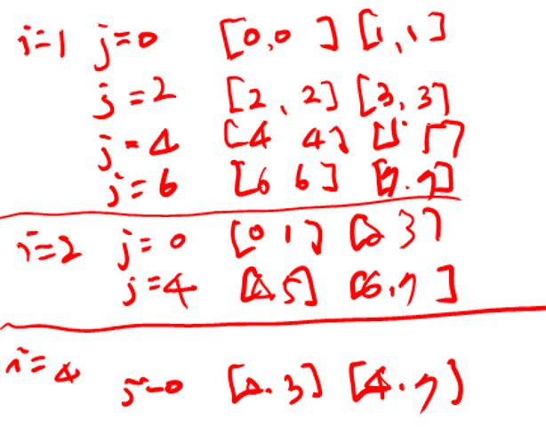
Nonrecursive Merge-Sort
public static void mergeSort(Object[] orig, Comparator c) { // nonrecursive
Object[] in = new Object[orig.length]; // make a new temporary array
System.arraycopy(orig,0,in,0,in.length); // copy the input
Object[] out = new Object[in.length]; // output array
Object[] temp; // temp array reference used for swapping
int n = in.length;
for (int i=1; i < n; i*=2) { // each iteration sorts all length-2*i runs
for (int j=0; j < n; j+=2*i) // each iteration merges two length-i pairs
merge(in,out,c,j,i); // merge from in to out two length-i runs at j
temp = in; in = out; out = temp; // swap arrays for next iteration
}
// the "in" array contains the sorted array, so re-copy it
System.arraycopy(in,0,orig,0,in.length);
}
protected static void merge(Object[] in, Object[] out, Comparator c, int start,
int inc) { // merge in[start..start+inc-1] and in[start+inc..start+2*inc-1]
int x = start; // index into run #1
int end1 = Math.min(start+inc, in.length); // boundary for run #1
int end2 = Math.min(start+2*inc, in.length); // boundary for run #2
int y = start+inc; // index into run #2 (could be beyond array boundary)
int z = start; // index into the out array
while ((x < end1) && (y < end2))
if (c.compare(in[x],in[y]) <= 0) out[z++] = in[x++];
else out[z++] = in[y++];
if (x < end1) // first run didn't finish
System.arraycopy(in, x, out, z, end1 - x);
else if (y < end2) // second run didn't finish
System.arraycopy(in, y, out, z, end2 - y);
}
merge runs of length 2, then 4, then 8, and so on
merge two runs in the in array to the out array

Slide 44
Quick-Sort
7 4 9 6 2 → 2 4 6 7 9
4 2 → 2 4
7 9 → 7 9
2 → 2
9 → 9

Slide 45
Quick-Sort (§ 10.2)
Quick-sort is a randomized sorting algorithm based on the divide-and-conquer paradigm:
Divide: pick a random element x (called pivot) and partition S into
L elements less than x
E elements equal x
G elements greater than x
Recur: sort L and G
Conquer: join L, E and G
x
x
L
G
E
x

Slide 46
Partition
We partition an input sequence as follows:
We remove, in turn, each element y from S and
We insert y into L, E or G, depending on the result of the comparison with the pivot x
Each insertion and removal is at the beginning or at the end of a sequence, and hence takes O(1) time
Thus, the partition step of quick-sort takes O(n) time
Algorithm partition(S, p)
Input sequence S, position p of pivot
Output subsequences L, E, G of the elements of S less than, equal to, or greater than the pivot, resp.
L, E, G ← empty sequences
x ← S.remove(p)
while ¬S.isEmpty()
y ← S.remove(S.first())
if y < x
L.insertLast(y)
else if y = x
E.insertLast(y)
else { y > x }
G.insertLast(y)
return L, E, G

Slide 47
Quick-Sort Tree
An execution of quick-sort is depicted by a binary tree
Each node represents a recursive call of quick-sort and stores
Unsorted sequence before the execution and its pivot
Sorted sequence at the end of the execution
The root is the initial call
The leaves are calls on subsequences of size 0 or 1
7 4 9 6 2 → 2 4 6 7 9
4 2 → 2 4
7 9 → 7 9
2 → 2
9 → 9

Slide 48
Execution Example
Pivot selection
7 2 9 4 3 7 6 1 → 1 2 3 4 6 7 8 9
7 2 9 4 → 2 4 7 9
3 8 6 1 → 1 3 8 6
2 → 2
9 4 → 4 9
3 → 3
8 → 8
9 → 9
4 → 4

Slide 49
Execution Example (cont.)
Partition, recursive call, pivot selection
7 2 9 4 3 7 6 1 → 1 2 3 4 6 7 8 9
2 4 3 1 → 2 4 7 9
3 8 6 1 → 1 3 8 6
2 → 2
9 4 → 4 9
3 → 3
8 → 8
9 → 9
4 → 4

Slide 50
Execution Example (cont.)
Partition, recursive call, base case
7 2 9 4 3 7 6 1 → → 1 2 3 4 6 7 8 9
2 4 3 1 →→ 2 4 7
3 8 6 1 → 1 3 8 6
1 → 1
9 4 → 4 9
3 → 3
8 → 8
9 → 9
4 → 4

Slide 51
Execution Example (cont.)
Recursive call, …, base case, join
7 2 9 4 3 7 6 1 → 1 2 3 4 6 7 8 9
2 4 3 1 → 1 2 3 4
3 8 6 1 → 1 3 8 6
1 → 1
4 3 → 3 4
3 → 3
8 → 8
9 → 9
4 → 4

Slide 52
Execution Example (cont.)
Recursive call, pivot selection
7 2 9 4 3 7 6 1 → 1 2 3 4 6 7 8 9
2 4 3 1 → 1 2 3 4
7 9 7 1 → 1 3 8 6
1 → 1
4 3 → 3 4
8 → 8
9 → 9
9 → 9
4 → 4

Slide 53
Execution Example (cont.)
Partition, …, recursive call, base case
7 2 9 4 3 7 6 1 → 1 2 3 4 6 7 8 9
2 4 3 1 → 1 2 3 4
7 9 7 1 → 1 3 8 6
1 → 1
4 3 → 3 4
8 → 8
9 → 9
9 → 9
4 → 4

Slide 54
Execution Example (cont.)
Join, join
7 2 9 4 3 7 6 1 → 1 2 3 4 6 7 7 9
2 4 3 1 → 1 2 3 4
7 9 7 → 17 7 9
1 → 1
4 3 → 3 4
8 → 8
9 → 9
9 → 9
4 → 4

Slide 55
Worst-case Running Time
The worst case for quick-sort occurs when the pivot is the unique minimum or maximum element
One of L and G has size n − 1 and the other has size 0
The running time is proportional to the sum
n + (n − 1) + … + 2 + 1
Thus, the worst-case running time of quick-sort is O(n²)
depth | time
0 | n
1 | n − 1
… | …
n − 1 | 1
…

Slide 56
Expected Running Time
Consider a recursive call of quick-sort on a sequence of size s
Good call: the sizes of L and G are each less than 3s/4
Bad call: one of L and G has size greater than 3s/4
A call is good with probability 1/2
1/2 of the possible pivots cause good calls:
7 2 9 4 3 7 6 1 9
7 2 9 4 3 7 6 1
2 4 3 1
7 9 7 1 → 1
1
7 2 9 4 3 7 6
Good call
Bad call
1 2 3 4 5 6 7 8 9 10 11 12 13 14 15 16
Bad pivots
Good pivots
Bad pivots

Slide 57
Expected Running Time, Part 2
Probabilistic Fact: The expected number of coin tosses required in order to get k heads is 2^{k}
For a node of depth i, we expect
i/2 ancestors are good calls
The size of the input sequence for the current call is at most (3/4)^{i/2}n
Therefore, we have
For a node of depth 2log_{4/3}n, the expected input size is one
The expected height of the quick-sort tree is O(log n)
The amount or work done at the nodes of the same depth is O(n)
Thus, the expected running time of quick-sort is O(n log n)

Slide 58
In-Place Quick-Sort
Quick-sort can be implemented to run in-place
In the partition step, we use replace operations to rearrange the elements of the input sequence such that
the elements less than the pivot have rank less than h
the elements equal to the pivot have rank between h and k
the elements greater than the pivot have rank greater than k
The recursive calls consider
elements with rank less than h
elements with rank greater than k
Algorithm inPlaceQuickSort(S, l, r)
Input sequence S, ranks l and r
Output sequence S with the elements of rank between l and r rearranged in increasing order
if l ≥ r
return
i ← a random integer between l and r
x ← S.elemAtRank(i)
(h, k) ← inPlacePartition(x)
inPlaceQuickSort(S, l, h − 1)
inPlaceQuickSort(S, k + 1, r)

Slide 59
In-Place Partitioning
Perform the partition using two indices to split S into L and E U G (a similar method can split E U G into E and G).
Repeat until j and k cross:
Scan j to the right until finding an element > x.
Scan k to the left until finding an element < x.
Swap elements at indices j and k
j
k
3 2 5 1 0 7 3 5 9 2 7 9 8 9 7 6 9
(pivot = 6)
j
k
3 2 5 1 0 7 3 5 9 2 7 9 8 9 7 6 9

Slide 60
Summary of Sorting Algorithms
Algorithm | Time | Notes
selection-sort | O(n²) | in-place slow (good for small inputs)
insertion-sort | O(n²) | in-place slow (good for small inputs)
quick-sort | O(n log n) expected | in-place, randomized fastest (good for large inputs)
heap-sort | O(n log n) | in-place fast (good for large inputs)
merge-sort | O(n log n) | sequential data access fast (good for huge inputs)

Slide 61
Java Implementation
public static void quickSort (Object[] S, Comparator c) {
if (S.length < 2) return; // the array is already sorted in this case
quickSortStep(S, c, 0, S.length-1); // recursive sort method
}
private static void quickSortStep (Object[] S, Comparator c,
int leftBound, int rightBound ) {
if (leftBound >= rightBound) return; // the indices have crossed
Object temp; // temp object used for swapping
Object pivot = S[rightBound];
int leftIndex = leftBound; // will scan rightward
int rightIndex = rightBound-1; // will scan leftward
while (leftIndex <= rightIndex) { // scan right until larger than the pivot
while ( (leftIndex <= rightIndex) && (c.compare(S[leftIndex], pivot)<=0) )
leftIndex++;
// scan leftward to find an element smaller than the pivot
while ( (rightIndex >= leftIndex) && (c.compare(S[rightIndex], pivot)>=0))
rightIndex--;
if (leftIndex < rightIndex) { // both elements were found
temp = S[rightIndex];
S[rightIndex] = S[leftIndex]; // swap these elements
S[leftIndex] = temp;
}
} // the loop continues until the indices cross
temp = S[rightBound]; // swap pivot with the element at leftIndex
S[rightBound] = S[leftIndex];
S[leftIndex] = temp; // the pivot is now at leftIndex, so recurse
quickSortStep(S, c, leftBound, leftIndex-1);
quickSortStep(S, c, leftIndex+1, rightBound);
}
only works for distinct elements

Slide 62
매우 큰 정수의 곱
MultiplyBigInteger.java
매우 큰 두 정수의 곱을 위해서 java.math.BigInteger class의 multiply 메쏘드를 사용하는 대신에 분할정복법으로 직접 구현할 수도 있다.
두 정수를 Standard Input에서 String으로 입력받은 뒤에, 이 두 수의 곱을 문자열의 크기가 1개가 될 때까지 재귀적으로 분할한 다음, 이 값을 곱하고 이 결과들을 다시 합하여 최종 곱셈의 결과를 만들고, 값을 출력한다.
(n자리의 두 정수를 곱한 경우, 결과는 크기가 2n 자리의 문자열에 저장)
x
y
9
1
0
9
2
7
3
8
×
2
0
1
2
1
2
2
5
x₁
x₂
y₁
y₂
x₁y₁
1
8
3
2
7
3
0
8
0
0
0
0
0
0
0
0
x₁y₂
0
0
0
0
1
1
1
5
8
5
2
5
0
0
0
0
x₂y₁
0
0
0
0
0
5
5
0
8
8
5
6
0
0
0
0
+
x₂y₂
0
0
0
0
0
0
0
0
0
3
3
5
4
0
5
0
1
8
3
2
8
9
7
4
7
7
1
6
4
0
5
0

Slide 63
Dynamic Programming

Slide 64
Matrix Chain-Products (not in book)
Dynamic Programming is a general algorithm design paradigm.
Rather than give the general structure, let us first give a motivating example:
Matrix Chain-Products
Review: Matrix Multiplication.
C = A*B
A is d × e and B is e × f
O(def ) time
f
B
j
e
e
A
C
d
i
i,j
d
f

Slide 65

Matrix Chain-Products
Matrix Chain-Product:
Compute A=A₀*A₁*…*A_{n-1}
A_{i} is d_{i} × d_{i+1}
Problem: How to parenthesize?
Example
B is 3 × 100
C is 100 × 5
D is 5 × 5
(B*C)*D takes 1500 + 75 = 1575 ops
B*(C*D) takes 1500 + 2500 = 4000 ops

Slide 66
An Enumeration Approach
Matrix Chain-Product Alg.:
Try all possible ways to parenthesize A=A₀*A₁*…*A_{n-1}
Calculate number of ops for each one
Pick the one that is best
Running time:
The number of paranethesizations is equal to the number of binary trees with n nodes
This is exponential!
It is called the Catalan number, and it is almost 4^{n}.
This is a terrible algorithm!

Slide 67
A Greedy Approach
Idea #1: repeatedly select the product that uses (up) the most operations.
Counter-example:
A is 10 × 5
B is 5 × 10
C is 10 × 5
D is 5 × 10
Greedy idea #1 gives (A*B)*(C*D), which takes 500+1000+500 = 2000 ops
A*((B*C)*D) takes 500+250+250 = 1000 ops

Slide 68
Another Greedy Approach
Idea #2: repeatedly select the product that uses the fewest operations.
Counter-example:
A is 101 × 11
B is 11 × 9
C is 9 × 100
D is 100 × 99
Greedy idea #2 gives A*((B*C)*D)), which takes 109989+9900+108900=228789 ops
(A*B)*(C*D) takes 9999+89991+89100=189090 ops
The greedy approach is not giving us the optimal value.

Slide 69
A “Recursive” Approach
Define subproblems:
Find the best parenthesization of A_{i}*A_{i+1}*…*A_{j}.
Let N_{i,j} denote the number of operations done by this subproblem.
The optimal solution for the whole problem is N_{0,n-1}.
Subproblem optimality: The optimal solution can be defined in terms of optimal subproblems
There has to be a final multiplication (root of the expression tree) for the optimal solution.
Say, the final multiply is at index i: (A₀*…*A_{i})*(A_{i+1}*…*A_{n-1}).
Then the optimal solution N_{0,n-1} is the sum of two optimal subproblems, N_{0,i} and N_{i+1,n-1} plus the time for the last multiply.
If the global optimum did not have these optimal subproblems, we could define an even better “optimal” solution.

Slide 70
A Characterizing Equation
The global optimal has to be defined in terms of optimal subproblems, depending on where the final multiply is at.
Let us consider all possible places for that final multiply:
Recall that A_{i} is a d_{i} × d_{i+1} dimensional matrix.
So, a characterizing equation for N_{i,j} is the following:
Note that subproblems are not independent--the subproblems overlap.

Slide 71
A Dynamic Programming Algorithm
Since subproblems overlap, we don’t use recursion.
Instead, we construct optimal subproblems “bottom-up.”
N_{i,i}’s are easy, so start with them
Then do length 2,3,… subproblems, and so on.
Running time: O(n³)
Algorithm matrixChain(S):
Input: sequence S of n matrices to be multiplied
Output: number of operations in an optimal paranethization of S
for i ← 1 to n-1 do
N_{i,i} ← 0
for b ← 1 to n-1 do
for i ← 0 to n-b-1 do
j ← i+b
N_{i,j} ← +infinity
for k ← i to j-1 do
N_{i,j} ← min{N_{i,j} , N_{i,k} +N_{k+1,j} +d_{i} d_{k+1} d_{j+1}}

Slide 72
DP Visualization
The bottom-up construction fills in the N array by diagonals
N_{i,j} gets values from pervious entries in i-th row and j-th column
Filling in each entry in the N table takes O(n) time.
Total run time: O(n³)
Getting actual parenthesization can be done by remembering “k” for each N entry
answer
N
0
1
2
j
…
n-1
0
1
…
i
n-1

Slide 73
The General Dynamic Programming Technique
Applies to a problem that at first seems to require a lot of time (possibly exponential), provided we have:
Simple subproblems: the subproblems can be defined in terms of a few variables, such as j, k, l, m, and so on.
Subproblem optimality: the global optimum value can be defined in terms of optimal subproblems
Subproblem overlap: the subproblems are not independent, but instead they overlap (hence, should be constructed bottom-up).

Slide 74
Subsequences (§ 11.5.1)
A subsequence of a character string x₀x₁x₂…x_{n-1} is a string of the form x_{i1}x_{i2}…x_{ik}, where ij < ij+1.
Not the same as substring!
Example String: ABCDEFGHIJK
Subsequence: ACEGIJK
Subsequence: DFGHK
Not subsequence: DAGH

Slide 75
The Longest Common Subsequence (LCS) Problem
Given two strings X and Y, the longest common subsequence (LCS) problem is to find a longest subsequence common to both X and Y
Has applications to DNA similarity testing (alphabet is {A,C,G,T})
Example: ABCDEFG and XZACKDFWGH have ACDFG as a longest common subsequence

Slide 76
A Poor Approach to the LCS Problem
A Brute-force solution:
Enumerate all subsequences of X
Test which ones are also subsequences of Y
Pick the longest one.
Analysis:
If X is of length n, then it has 2^{n} subsequences
This is an exponential-time algorithm!

Slide 77
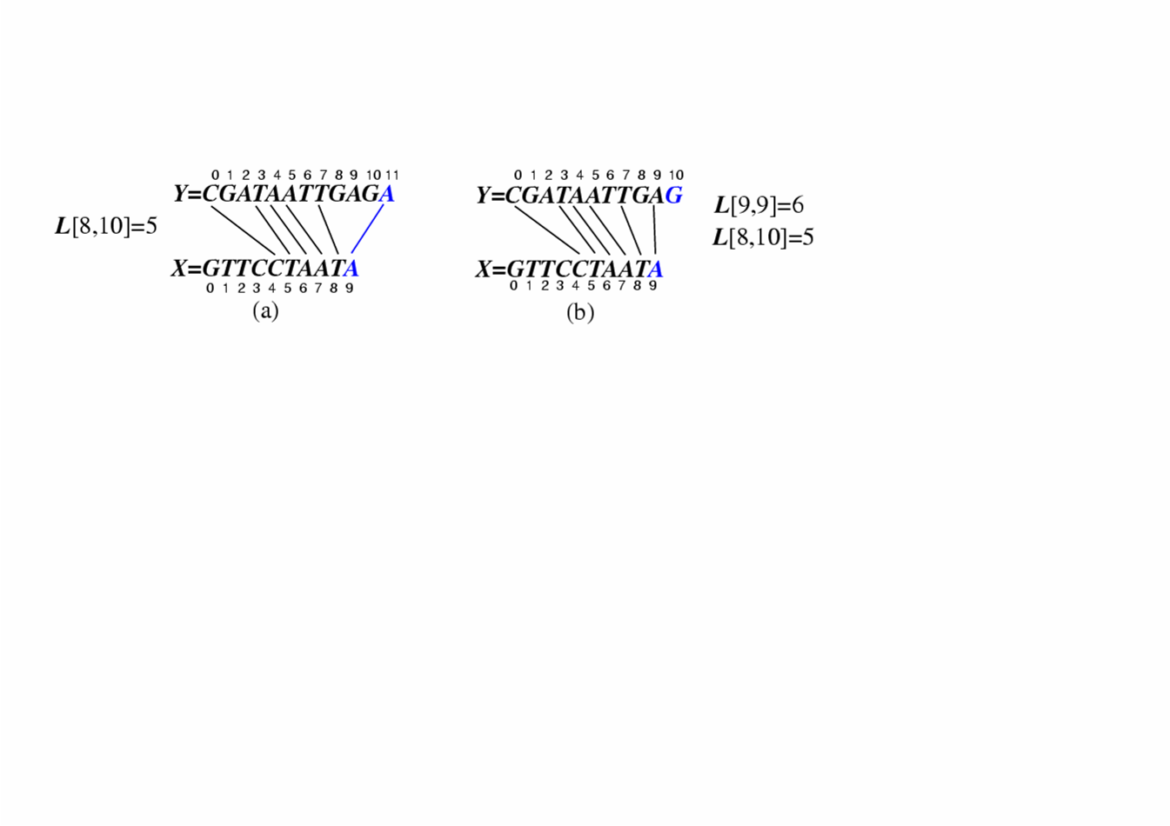
A Dynamic-Programming Approach to the LCS Problem
Define L[i,j] to be the length of the longest common subsequence of X[0..i] and Y[0..j].
Allow for -1 as an index, so L[-1,k] = 0 and L[k,-1]=0, to indicate that the null part of X or Y has no match with the other.
Then we can define L[i,j] in the general case as follows:
If xi=yj, then L[i,j] = L[i-1,j-1] + 1 (we can add this match)
If xi≠yj, then L[i,j] = max{L[i-1,j], L[i,j-1]} (we have no match here)
Case 1:
Case 2:

Slide 78
An LCS Algorithm
Algorithm LCS(X,Y ):
Input: Strings X and Y with n and m elements, respectively
Output: For i = 0,…,n-1, j = 0,...,m-1, the length L[i, j] of a longest string that is a subsequence of both the string X[0..i] = x₀x₁x₂…x_{i} and the string Y [0.. j] = y₀y₁y₂…y_{j}
for i =1 to n-1 do
L[i,-1] = 0
for j =0 to m-1 do
L[-1,j] = 0
for i =0 to n-1 do
for j =0 to m-1 do
if x_{i} = y_{j} then
L[i, j] = L[i-1, j-1] + 1
else
L[i, j] = max{L[i-1, j] , L[i, j-1]}
return array L

Slide 79
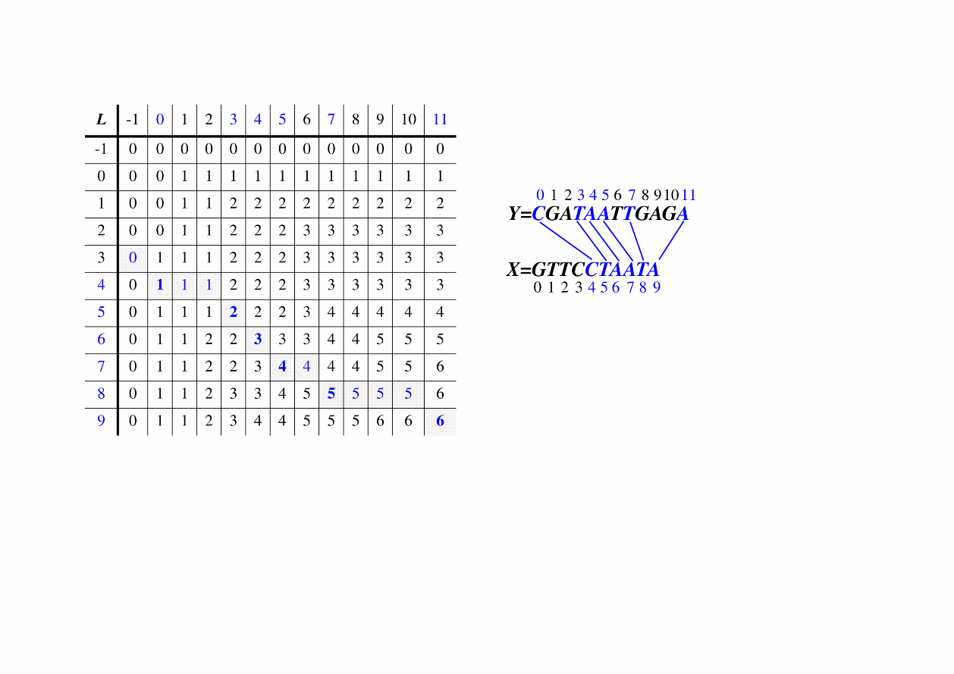
Visualizing the LCS Algorithm

Slide 80
Analysis of LCS Algorithm
We have two nested loops
The outer one iterates n times
The inner one iterates m times
A constant amount of work is done inside each iteration of the inner loop
Thus, the total running time is O(nm)
Answer is contained in L[n,m] (and the subsequence can be recovered from the L table).

